Slide 1
Pipeline development and Training for High Throughput NGS Data Analyses
Vishal N Koparde, Ph.D.
CCR Collaborative Bioinformatics Resource
01/24/2019

Slide 2
CCBR→ CCR Collaborative Bioinformatics Resource
Maggie Cam, Ph.D. (Head)
Richard Finney, M.Sc. (CBIIT)
Parthav Jailwala, M.Sc. (Manager)
Vishal Koparde, Ph.D. (Supervisor)
CCBR Bioinformatics Analysts:
Abdalla Abdelmaksoud, B.Sc.
Alexei Lobanov, Ph.D.
George Nelson, Ph.D.
Mayank Tandon, Ph.D.
Skyler Kuhn, M.Sc.
Thomas Joshua Meyer (Josh), Ph.D.

Slide 3
What does CCBR do?
• Experimental Design and Technology/Strategy advice
• Data analysis and interpretation esp. genomics, NGS data
• Freely available to all CCR investigators/scientists
• Collaborative support on manuscripts (over 50 co-authored papers in last 4 years)
• Develop, maintain and train researchers on NGS data analysis pipelines

Slide 4
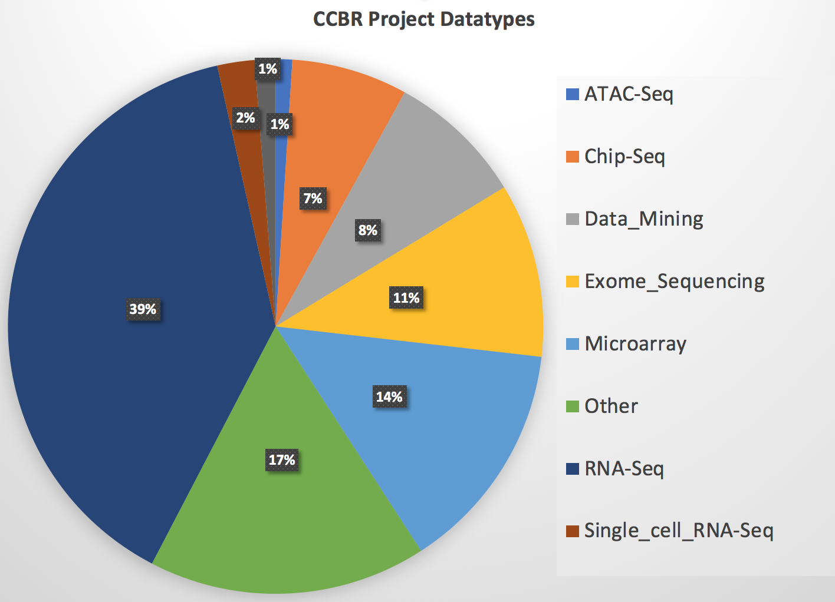
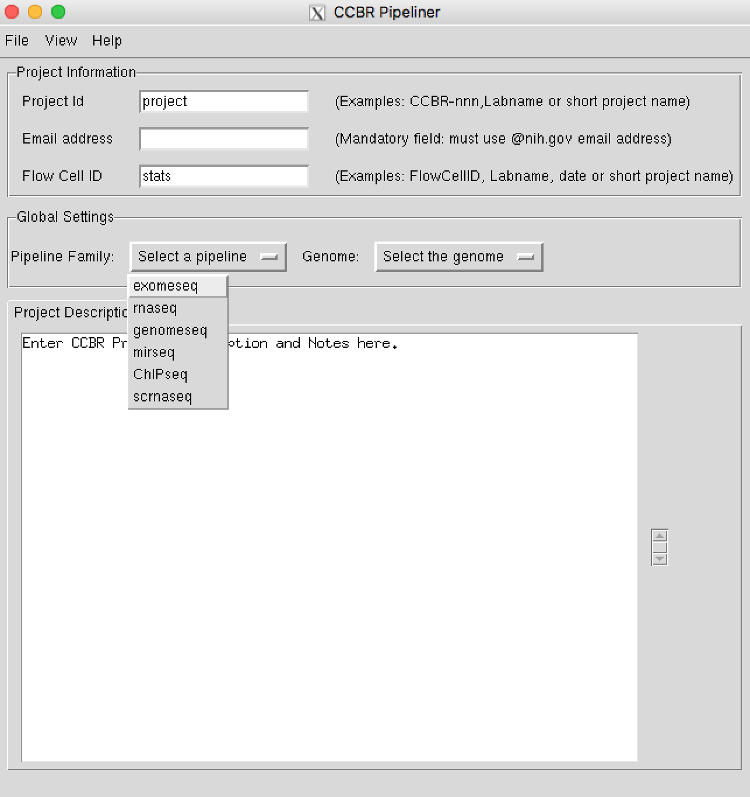
CCBR/NCBR pipelines on Biowulf
ExomeSeq
RNASeq
GenomeSeq
miRNASeq
ChIPSeq
scRNASeq
ATACSeq (soon)
Grown year-by-year in options and number of users
Frequent enhancements by CCBR/NCBR

Slide 5
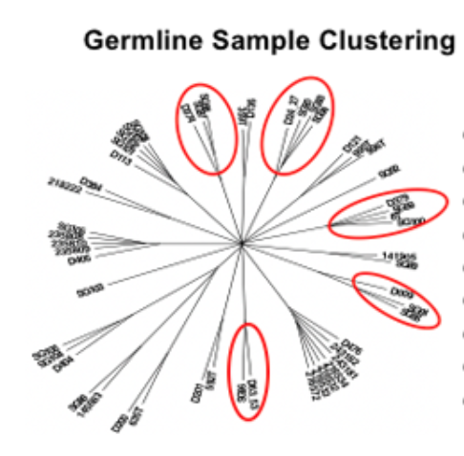
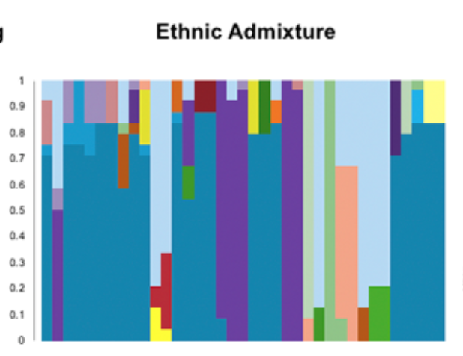
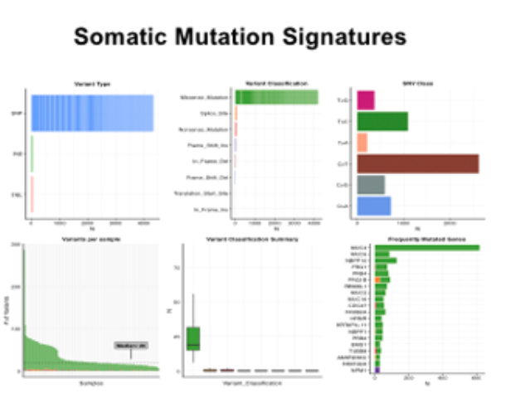
WES/WGS Variant
Workflow(s)
FREEC
Sequenza

Slide 6
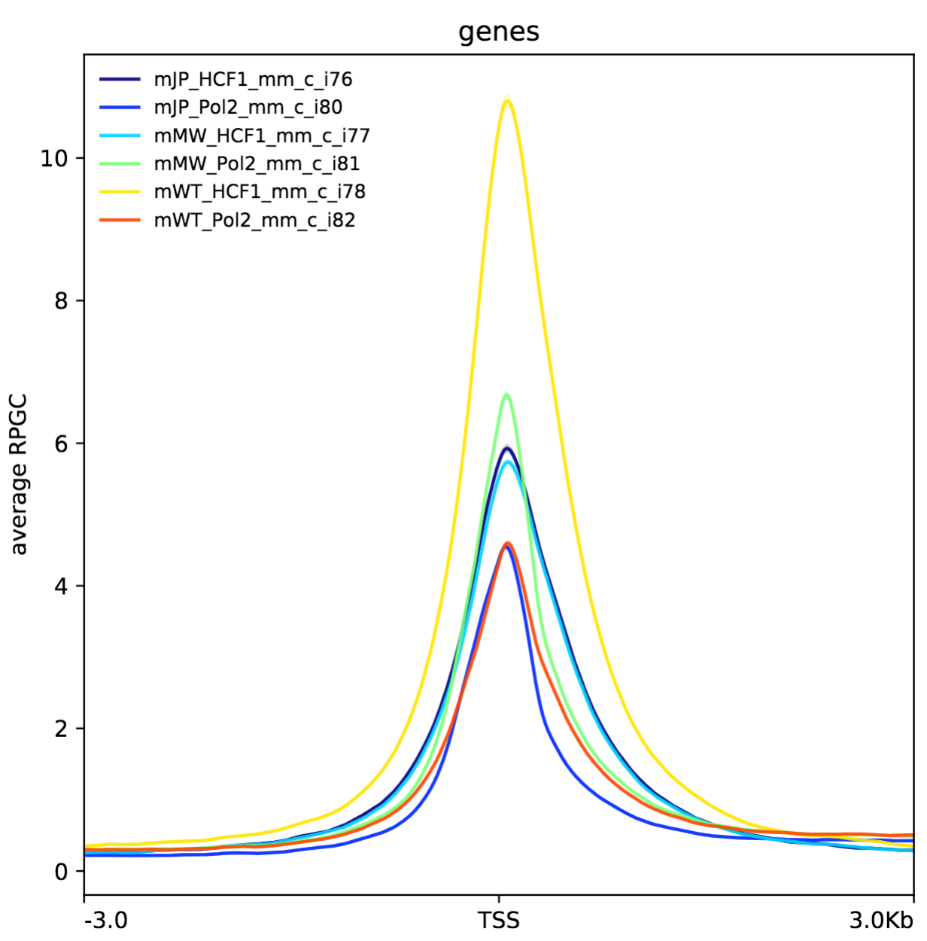
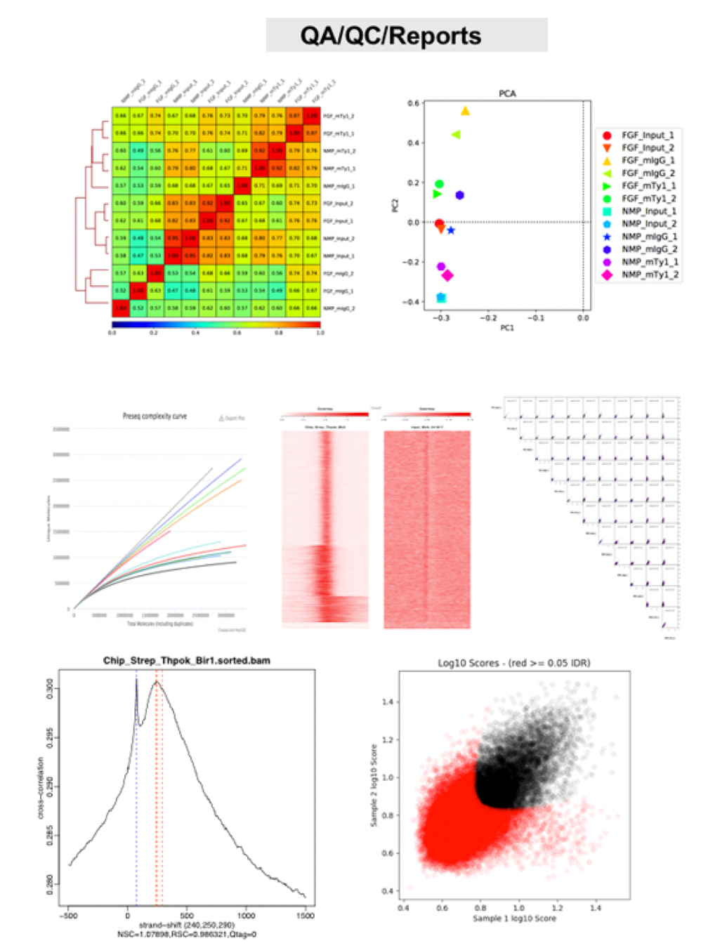
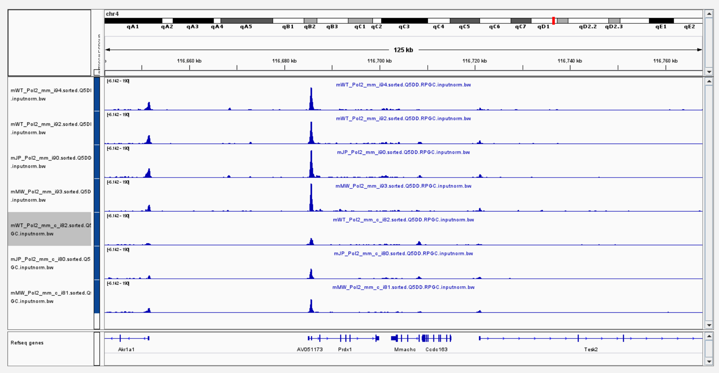
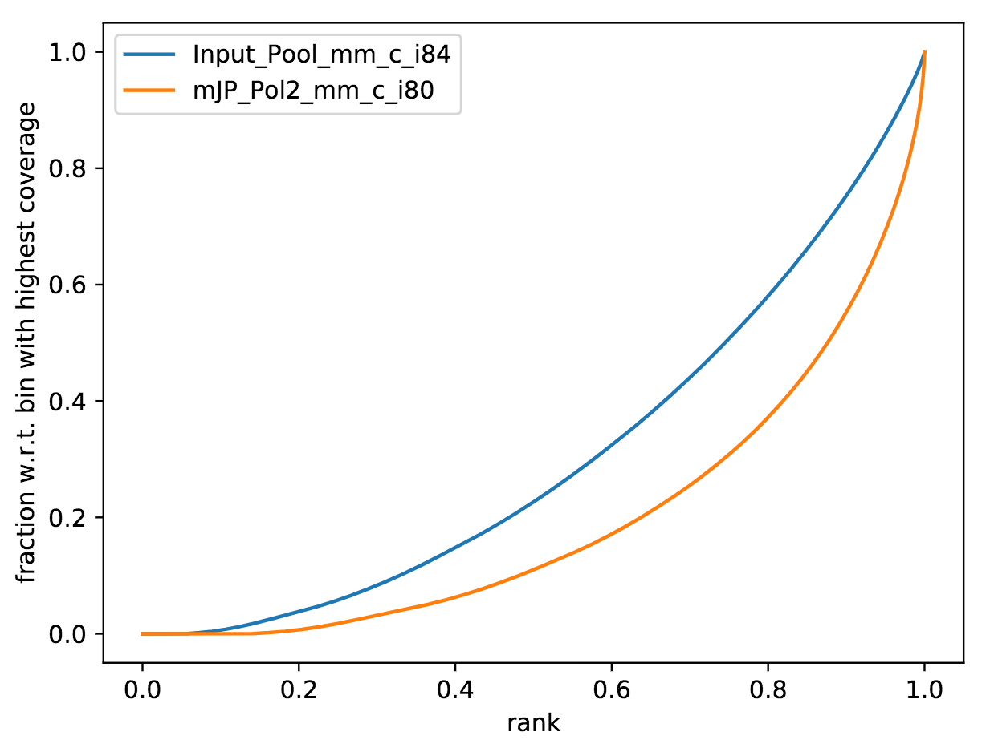
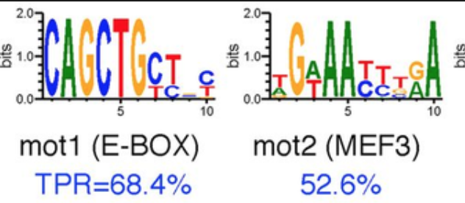
CCBR/NCBR ChIPSeq pipeline
Input → Fastq files
Extensive QC : PPQT, deeptools, PCA, preseq, fingerprint plot, TSS enrichment, etc.
Outputs
Peaks→ multiple
IGV visualizations
IDR → replicate concordance
Motif analysis
Pathway analysis
Human/Mouse reference genomes
TSS enrichment
IGV visualization
motifAnalysis
FingerprintPlot

Slide 7
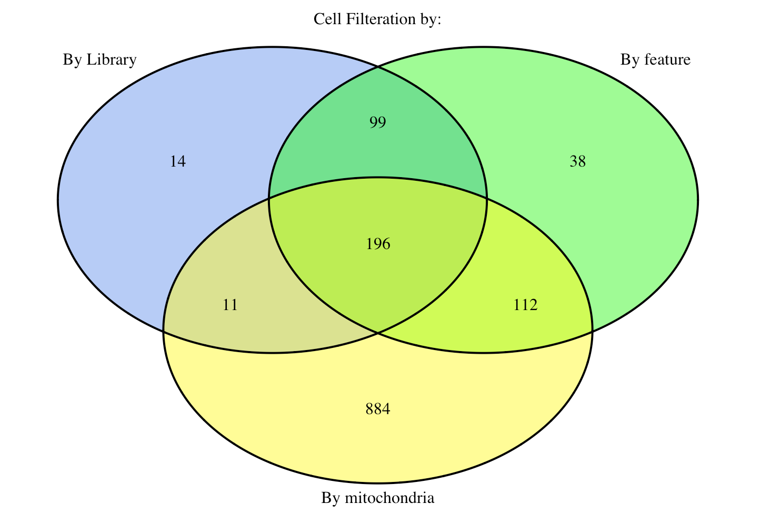
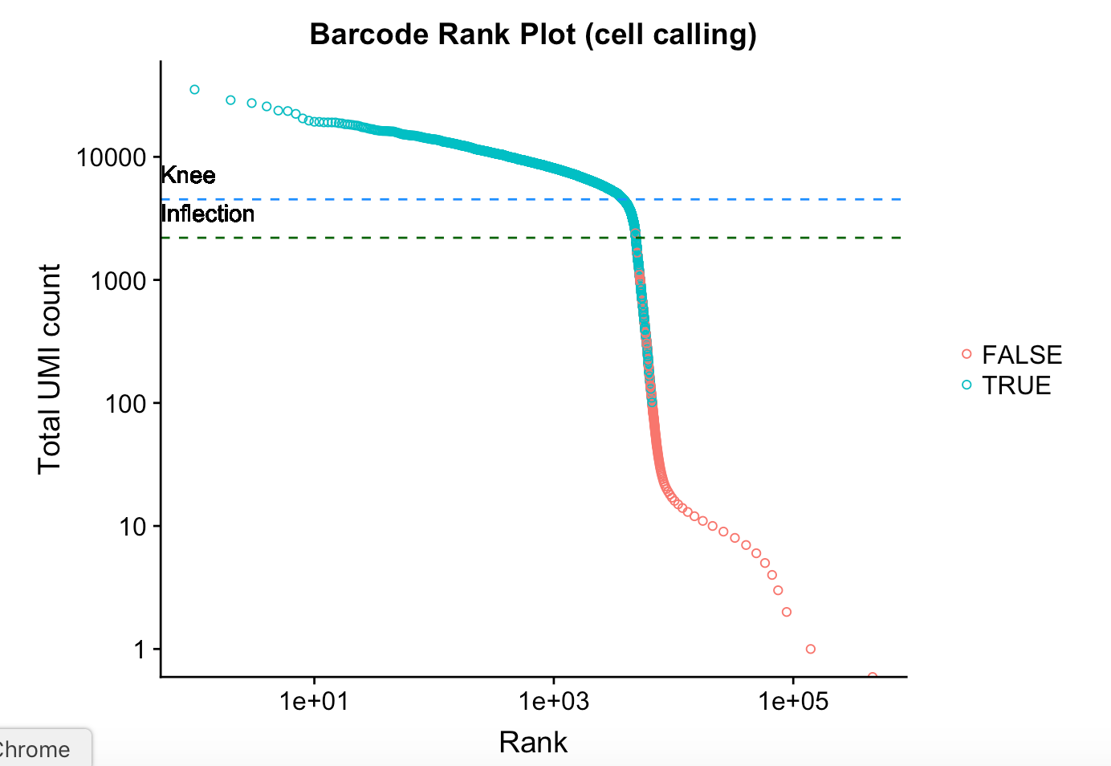
CCBR/NCBR scRNASeq pipeline
Input → Fastq files or countmatrix
10X Genomics datasets only (CellRanger)
Demultiplexing (Umitools)
Filtering (Scran)
Cell cycle phase correction (Scran)
Remove Empty Droplets and Doublets (DoubletFinder)
Integrate multiple datasets (Seurat
Clustering (Seurat)
Determine gene markers (Seurat)
UMAP visualizations (Seurat)
Inter-cluster differential expression (MAST)
Cluster annotation (SingleR)

Slide 8
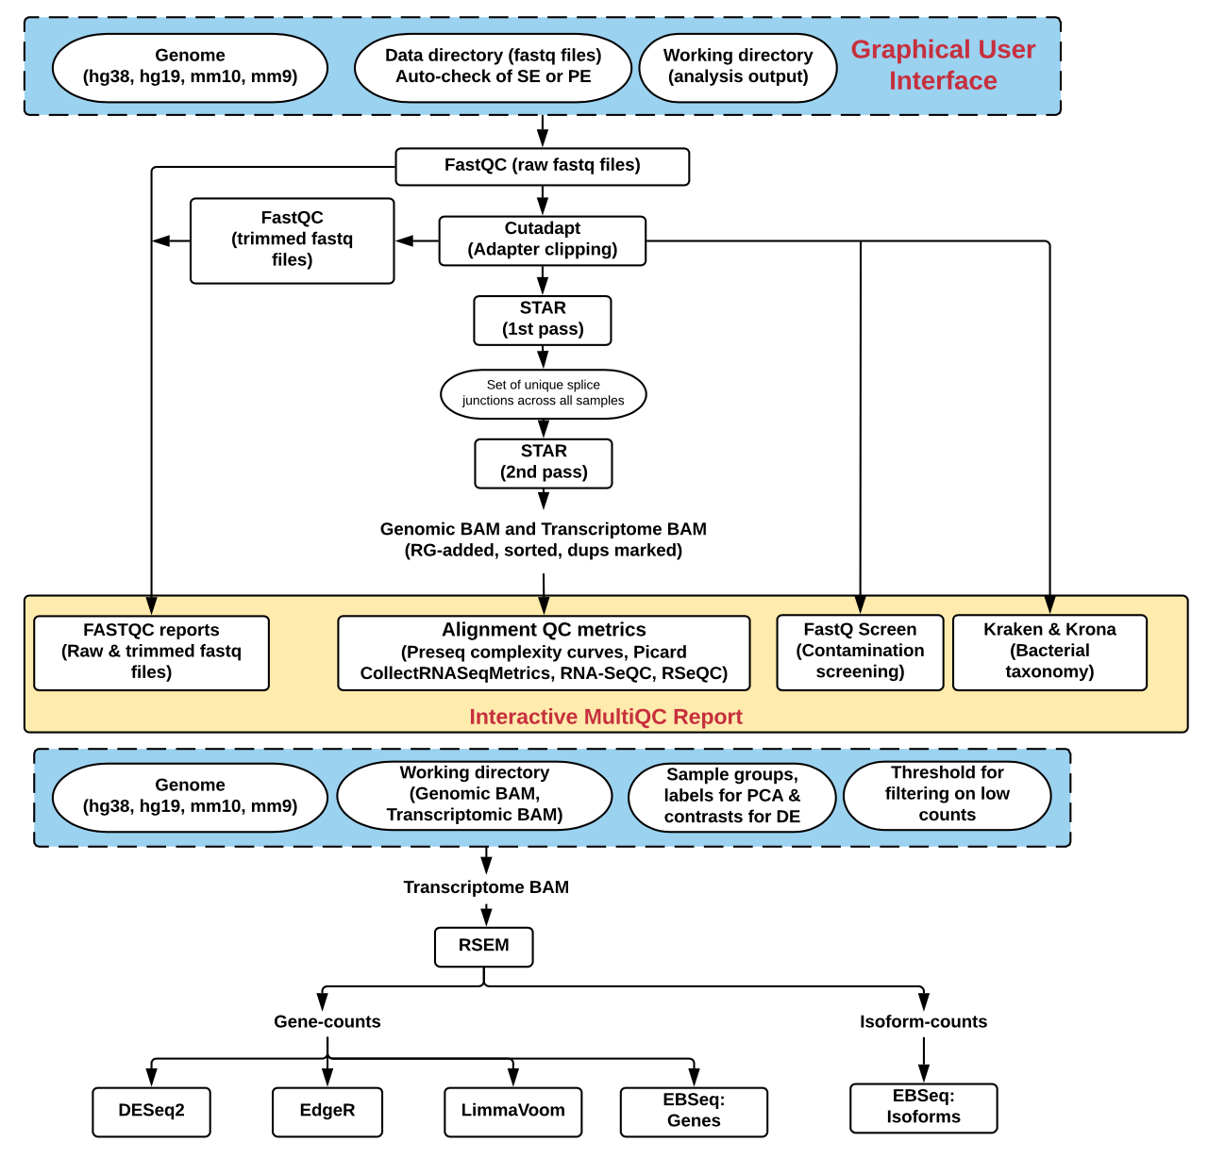
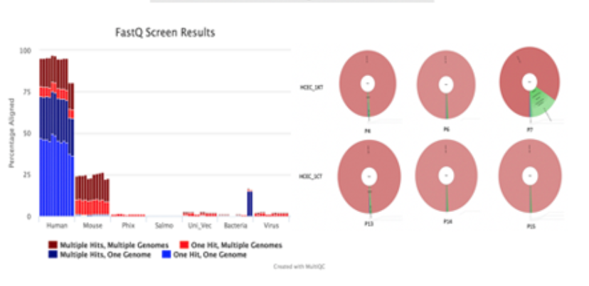
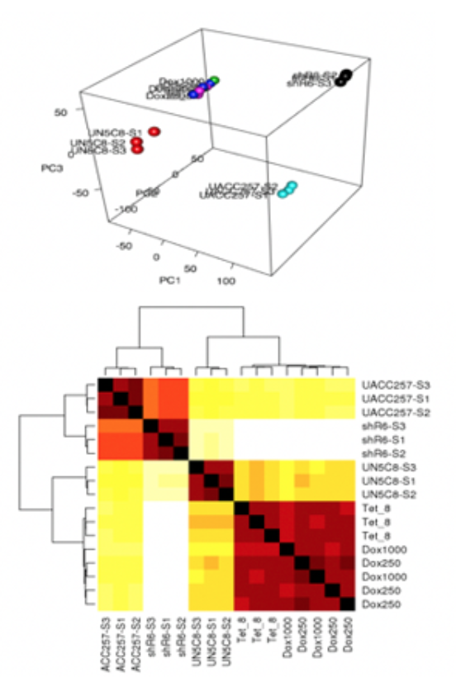
CCBR/NCBR RNASeq pipeline
Input → Fastq files
Extensive QC: Fastqscreen, Kraken, RseQC, Picardtools
Outputs
Count matrix
PCA plots
GSEA
Isoform level counts
DEG results
Volcano plots
Pathway analysis
Human/Mouse reference genomes

Slide 9
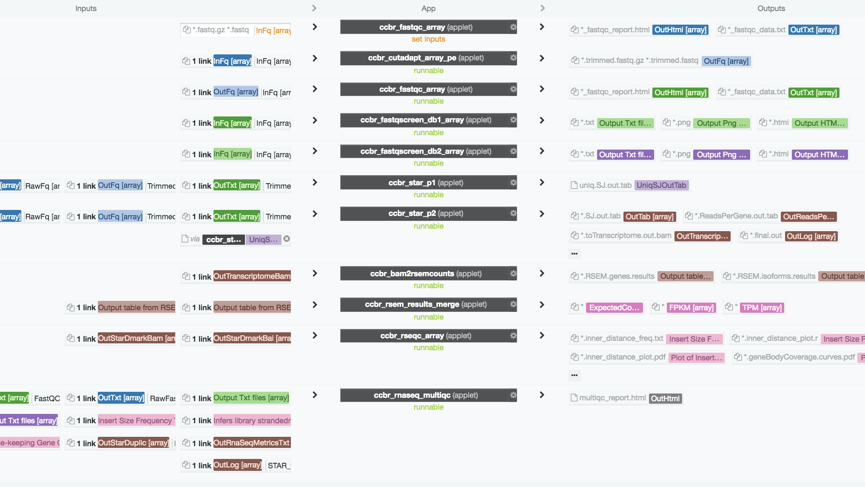

Moving to the CLOUD!
Build dockers
Build applets
Build workflows
Test
Repeat!

Slide 10
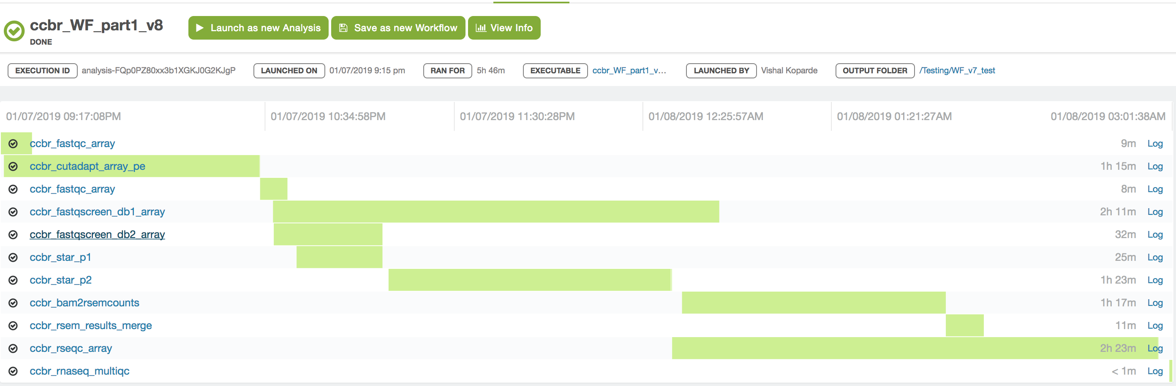
Job monitoring on DNAnexus
End-to-end RNASeq pipeline → Ready now!
Optimized for parallel processing
Can be executed using the webpage or CLI

Slide 11




Future direction:
Note: Blue dashed lines indicate areas in development
Front end upload
(Available)
Palantir Wrapper Code
(Testing)
Palantir Data Connector
(In development)
Network Drive
Limma
Voom
Heatmap
Biowulf
Palantir S3
DNAnexus Pipeline
Batch Removal
PCA Plot
FastQ Files and Metadata
Counts with RSEM and pipeline config metadata
Differential Expression
Cleversafe
HPCDME
Volcano Plot
Notes:
NetService Account
Virtual Machine
Steps we’re able to do now, and steps are in development
FR – a lot of fastq that exists in Biowulf, can we bring the files there
- Network drive (Collaborators can send these)
- Multiple scenarios work

Slide 12
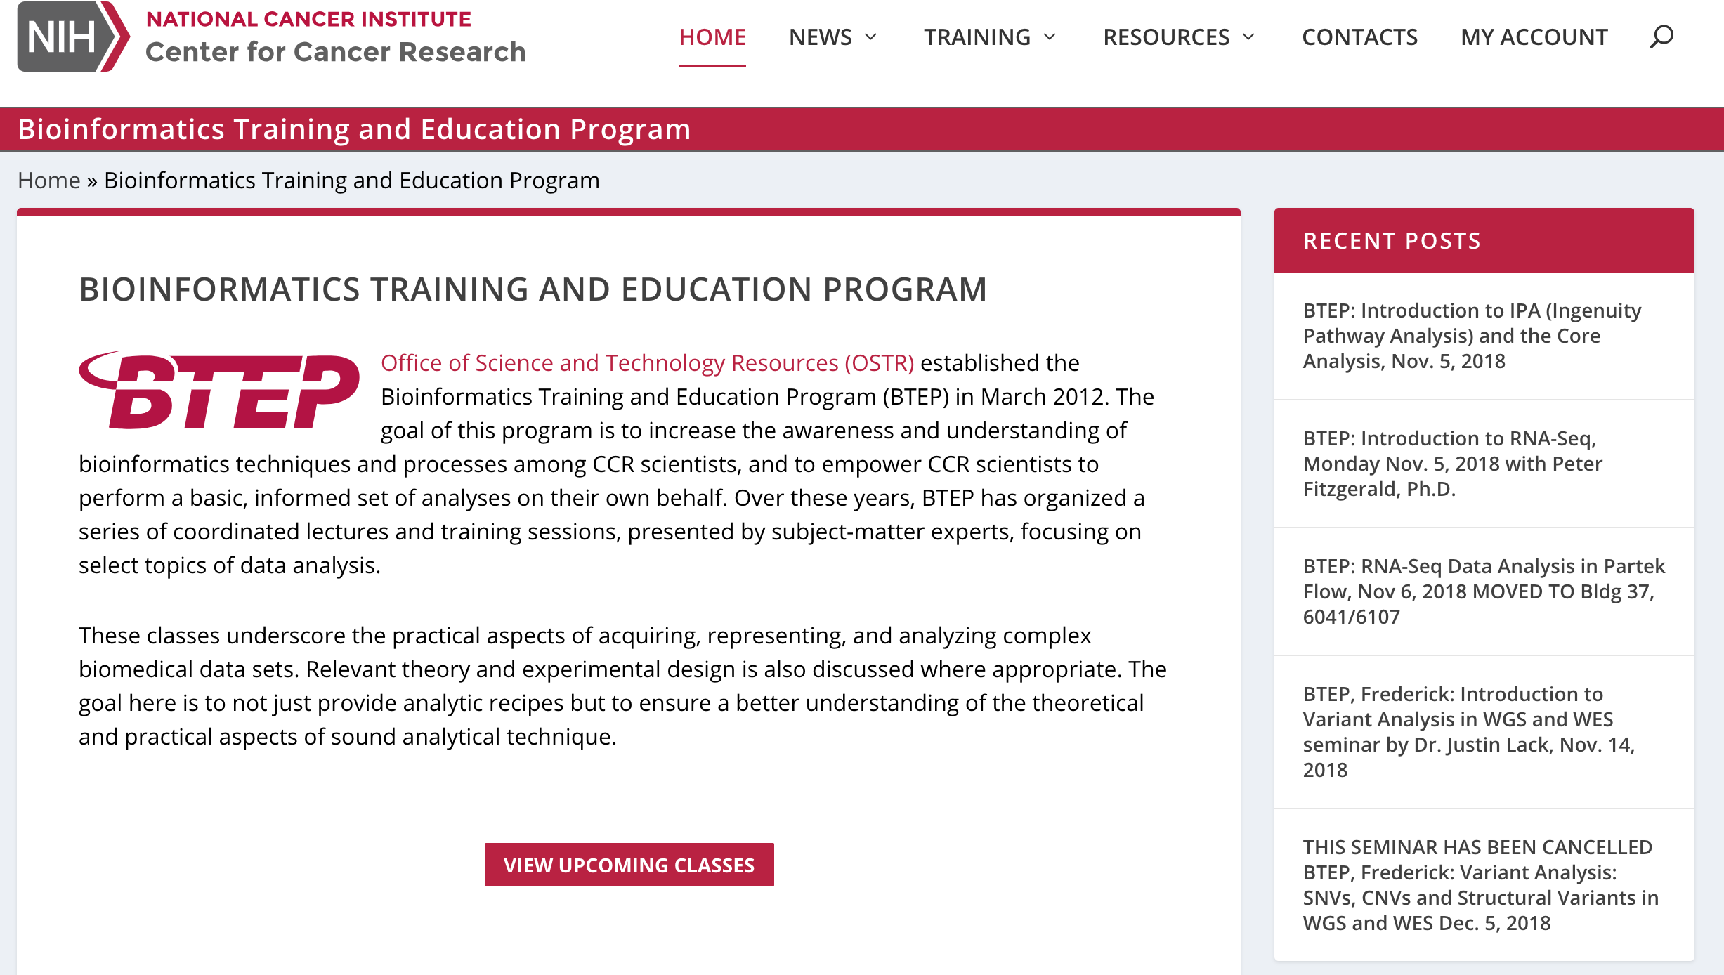
Training
Hand-on training
Personalized one-on-one consultation
Rotating schedule
https://btep.ccr.cancer.gov/

Slide 13
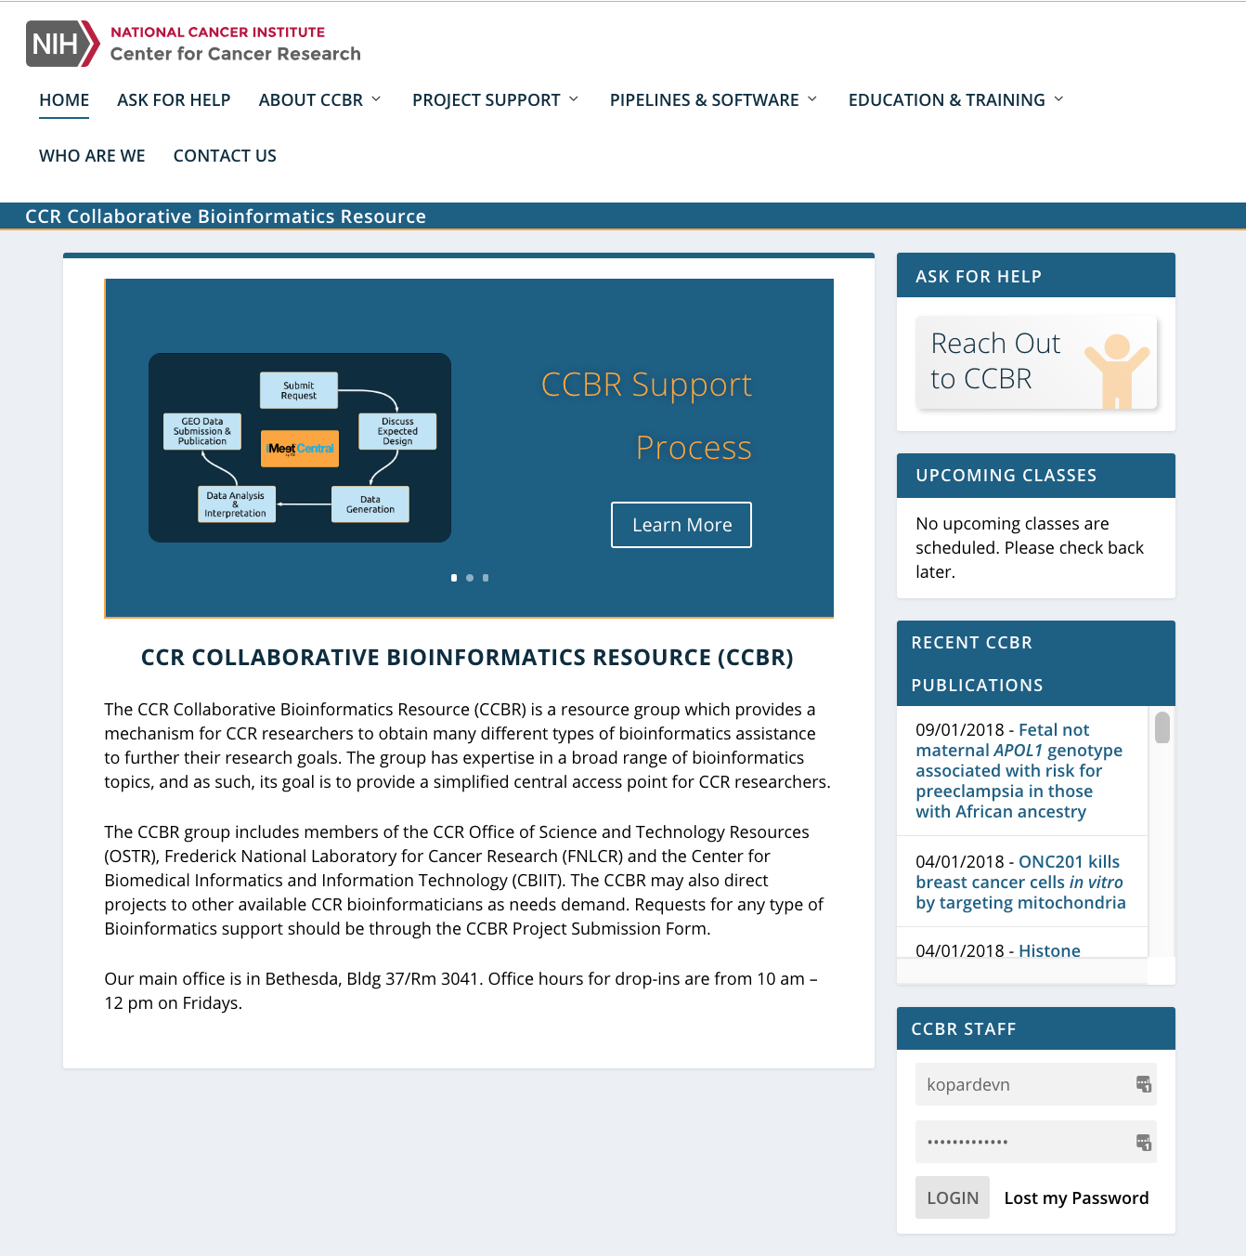
https://ccbr.ccr.cancer.gov/
https://btep.ccr.cancer.gov/
https://github.com/CCBR/Pipeliner
Questions?

